Slide 1

Feedback & Vendor Rating Model
San Donato Milanese, December 1st 2022

Slide 2


Agenda
1st Part Supplier Management
The key objectives of Vendor Management and its organization in Eni S.p.A.
The measure of supplier performance
2nd Part The Performance Feedback Model
Relevant Commodity Classes
The evaluation tool: the Execution Feedback Questionnaire

Slide 3

Supplier Management
Can we totally rely on the other party?
The evaluation process allows you to answer this question.
It is divided into several phases and aims at motivating suppliers to improve their performance
Supplier Qualification → verification of suppliers’ potential and capabilities and of their correct implementation of company procedures (ex-ante)
Supplier Feedback → measurement and monitoring of suppliers’ performance to ensure contractual compliance, mitigate risks and direct them towards continuous improvement (ex-post)

Slide 4
Organizational structure
Who is in charge of Supplier Management?
VENDOR MANAGEMENT & DEVELOPMENT
Rossano Francia
SUPPLIER SUSTAINABILITY, COORDINATION & DEVELOPMENT
Stefano Fasani
ENERGY EVOLUTION & TECH QUALIFICATION
Marco Casati
NATURAL RESOURCES QUALIFICATION & MARKET SCOUTING
Nicola Resta
SUPPORT FUNCTIONS QUALIFICATION
Sonia Bianco
VENDOR MANAGEMENT SERVICES
Manuela Lunetta
ENERGY EVOLUTION
Giovanni Polizzi
DRILLING & WELL SERVICES
Luca Ferri
COMMERCIAL & COMMUNICATION Paolo Marovino
VENDOR DEVELOPMENT
Francesco Fabbri
R&D / DIGITAL / ICT
R.T.
MAINTENANCE & ENVIRONMENT
Paola Pedruzzi
SERVICES
R.T.
SUPPLIER EVALUATION TEAM
Elena Dal Maso
MARKET SCOUTING Domenico Mundo

Slide 5
The Integrated Vendor Management system
Potential evaluation
ex-ante
Performance evaluation
ex-post
Market
Intelligence
Supplier
Qualification
Tender
Vendor List/Tenders
Feedback
Misconduct
Serious non-performance
Technical
Products and services
Technical references
Capabilities and technical requirements on products and services provided
Punctuality, Quality
and Behavior
Technical tabulation
Economic
Macro economic
indicators
Economic stability and
price/cost variations
Financial position
Economic tabulation
Compliance
Regulatory compliance
Respect of Eni's Code of Ethics
Tender requirements
fulfillment
Correct documentation,
laws / regulations and Eni
standards compliance
Performance
Due Diligence
HSE
HSE expertise and relevant violations reports
Regulatory compliance, certifications and HSE system effectiveness
Tender requirements
fulfillment
Incidents/injuries
Contract specifications
compliance
Commercial Behavior
Commercial and organizational expertise
Commercial expertise and competitive advantages
Organization and
Supervision of SOW
Accuracy, availability and competitiveness
Input to potential
vendor list
review (need for new
markets, new suppliers)
Impact on new
qualification
Impact on tender Scoring Model and vendor list
IMPACT
Impact on vendor
qualification status

Slide 6



Types of feedbacks and evaluations
Feedbacks
Evaluation mechanisms
Supplier Final Evaluation
Vendor Rating
Index (IVR)**
Performance feedbacks
Mandatory FB*
Voluntary and Mandatory FB
Performance Indicator (IP)***
Serious non-performance feedbacks
Evaluation Team
Indicator below the acceptability thresholds (50/100)
Misconduct
feedbacks
Supplier status
Supplier status (Active Status, Warning Status with Authorization, Suspended, Disqualified)
(*) Suppliers qualified by the HQ, International and Megasupplier vendors; more than 450.000€ for open contracts and more than 150.000€ for closed contracts
(**) To calculate Vendor Rating, each feedback remains effective for 36 months; it will be necessary a minimum of 3 feedbacks to have a significant Vendor Rating
(***) The Performance Indicator is the final evaluation related to specific performance feedback (the IP is calculated on all types of feedback)

Slide 7
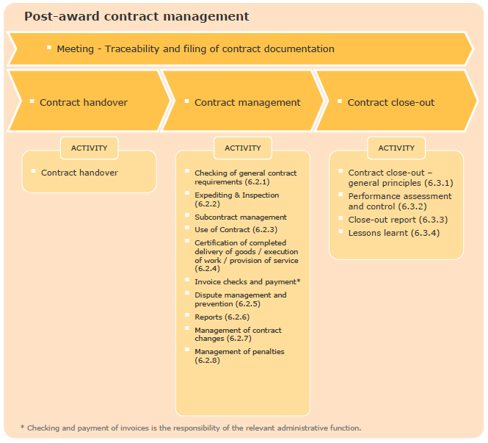


The Performance Feedback - execution
SCOPE
→ successful supplier in the execution phase of the contract
collect information on the supplier’s behavior
measure the level of performance provided by the supplier, also in terms of compliance with HSE requirements
acquire information on the behavior of all parties who, on behalf of the supplier, have operated under the contract
The Contract Holder:
identifies the feedback compiler figure
takes care of the correct execution of the feedback compilation activities and approves it
manages the notification to the supplier in the cases provided for by the legislation
Source: Post-award contract management Procedure -pro pr 001 eni spa r04
Notes:
ROLES AND RESPONSIBILITIES IN THE MANAGEMENT OF THE EXECUTION FEEDBACK PROCESS
Receiving unit: business unit that receives the goods or works / services. It is responsibility of the receiving unit to carry out the technical-operational control of the goods received, the materials installed and the services / works received
User unit: draws up the supplier performance evaluation feedback
Holder unit: takes care of receiving notifications from user units regarding any anomalies detected during the execution of the contract, also for the purpose of issuing feedback
HSE contact person: monitors and evaluates the supplier on HSE aspects and completes the questions in the HSE section of the execution feedback form (*), detects and reports to the contract holder any serious breaches or offenses detected in the HSE area
(*) In the case of Commodity Classes with high or significant HSE criticality (A or B)
Sources:
Procedure: Post-award contract management Procedure - pro pr 001 eni spa r04
Procedure: Vendor Performance Evaluation & Vendor Rating- pro pr 011 eni spa r02

Slide 8
Information flows
VMS System
Compiler
Contract Holder
At the annual recurrence of the contract validity start date, VMS sends an email to the compiler to request the compilation of the execution feedback
Deadline = 30 days from the email
1
The compiler, which monitors the vendor's performance, fills out the execution feedback form in VMS
4
The Contract Holder approves the feedback and manages the notification to the supplier
2
3
Site HSE contact person
5
They monitor and evaluate the supplier on HSE aspects and fill in the HSE section of the feedback
5
7
6
VEMAD-A
7
Quarterly analysis of feedback with sub-threshold score and possible management in the Evaluation Team of misconduct
/ serious non-performance

Slide 9

Focus Abroad - Performance Feedback elaboration and collection
According to the MSG Procurement, Procurement Managers abroad actively manage local suppliers feedbacks and are responsible for collecting and communicating to VEMAD the mandatory performance feedbacks (mandatory CC, contract value, type of vendor - i.e. Megasupplier, International, Italian)
Feedbacks management flow
VEMAD
PROCUREMENT MANAGER
Manages foreign feedback process:
supports Contract Holders in identifying contracts within scope*, collects approved .xls FBs, and when needed, manages FB transmission (through VMS) to VEMAD for International, Italian and Megasuppliers
identifies tenders within scope* and collects approved .xls tender FBs, managing FB transmission to VEMAD (through VMS) for International, Italian and Megasuppliers
periodically receives a report with suppliers performances
VMS
Upload FBs in VMS (Vendor Management System)
Upload FBs in VMS (Vendor Management System)
Suppliers performances report
Procurement Manager or Contract Holder Approver
FB Technical Managers
Require FBs within scope*
Require FBs within scope*
Send FBs xls
Send FBs .xls
Buyer
Contract holder
(*) The VMS system automatically sends the request of evaluation to "user evaluator" if the contract or tender is managed through to GPS/SIA systems

Slide 10







Performance Feedback Model - Execution Feedback
2021-2022
From December 2022
PILOT
79 relevant Commodity Classes
FB questionnaire on a scale of 1 to 5
Strengthening of mandatory FB supervision
Tool
Questions
Evaluation scale
Contract holder preferences
ANALYSIS
MODEL
CONTROL MODEL
SUPPLIER CLUSTERING
QUALIFICATION UPDATE
RISK MANAGEMENT INTEGRATED MODELS

Slide 11
Identification of relevant Commodity Classes (CCs)
OLD
EVALUATION CRITERIA
2015
1st oct 22
27 CCs
79 CCs
CRITICAL ISSUES
RELEVANCE
SINERGIES
Business - A: 14%
HSE - A: 8%
Human Rights - A: 8%
Business - A: 41%
HSE - A: 26%
Human Rights - A: 64%
DRIVERS
BUSINESS
HSE
HUMAN RIGHTS
CYBER
AWARDED CONTRACTS
CONTRACTS NUMBER
AWARDED CONTRACTS IMPACT IN ITALY
STRATEGICAL CC
RMI CC
CRITICAL ISSUES
Awarded contracts: 19%
Contracts nr.: 4%
Awarded contracts impact in Italy: 20%
Awarded contracts: 50%
Contracts nr..: 11%
Awarded contracts impact in Italy : 45%
EFFECTIVENESS OF 79 CCs
CRITICAL ISSUES: greater coverage of high-risk activities
RELEVANCE: coverage of 50% of the awarded contracts worldwide with 11% of contracts
SYNERGIES: synergies with strategic CCs and RMI
RELEVANCE
Strategical CCs: 26%
RMI CCs: 0%
Strategical CCs : 63%
RMI CCs : 67%
SINERGIES
18 Mrd.
Value of contracts mandatory FB
+3
New Commodity Sectors
Relevant EE contracts intercepted
(+ 6% incidence in value)
EFFORT
Holder unit: 292
Annual Feedback nr.: 945
Holder unit: 460
Annual Feedback nr.: 2.410
-2%
NR incidence on total intercepted value
X3,5

Slide 12
Relevant Commodity Classes
14 Commodity Sectors intercept 50% of the Procurement
Mandatory FB :
Close contract > 150 K€
Open contract > 450K€
Timing:
At least once a year
Closing of the contract

Slide 13


Execution Feedback Questionnaire
QUALITY
1
To what extent has the supplier been punctual in respecting the terms of delivery / fulfillment of the requested goods / services?
REPORTING CRITICAL ISSUES
QUALITY
2
To what extent were the results of the supplier's activity in line with the requirements set out in the contractual specifications?
Failure by the supplier to comply with the applicable labor legislation
1
QUALITY
3
To what extent has the supplier's staff proved to be adequate, trained and aware of the activities to be carried out?
How do you evaluate the organization, the ability and the accuracy demonstrated by the supplier in the execution of the contract as a whole?
Failure to comply with contractual obligations of an administrative nature and / or rules on subcontracting
QUALITY
4
2
SAFETY*
5
Violations of the HSE provisions of the contract
3
Failure to comply with Eni Code of Ethics / Code of Conduct
SAFETY*
6
Frequency index
Events indicative of a potential risk situation regarding the economic / financial soundness of the supplier
SAFETY*
7
Percentage of contractor staff trained in HSE as per the training planned
4
SAFETY*
8
Percentage of the number of HSE actions closed out of the total number of actions to be closed in the period (the actions to be closed are communicated to the contractor and originate from inspections, verifications and audits)
5
Cybersecurity breach events detection?
COMPLIANCE
How do you evaluate the technical / accounting documentation presented by the supplier with respect to the service actually performed?
9
6
Evidence or news of crimes
COMPLIANCE
10
To what extent was the accounting of the works accurate and timely?
Evidence or news of violation of regulations or opening of civil / criminal proceedings against the supplier or its administrators
On the basis of the available information, has the supplier guaranteed respect for human rights? (e.g. critical issues: use of child labor, forced or compulsory labor, discrimination, working hours, freedom of association and right to collective bargaining, unhealthy working environment)
7
COMPLIANCE
11
With reference to the ESG-Sustainability issues relevant to the subject of the contract, how do you evaluate the behavior of the supplier?
No Impact on Performance Score
SUSTAINABILITY
12
More truthful representation of companies distribution by score range
Greater possibility of answering → more effective evaluation and adherence to the opinions of contract managers
*Questions in line with the HSE assessment model.
The model returns an evaluation on a scale of 1-5
Notes:
*Questions in line with the HSE assessment model. The model returns a rating on a scale of 1-5

Slide 14
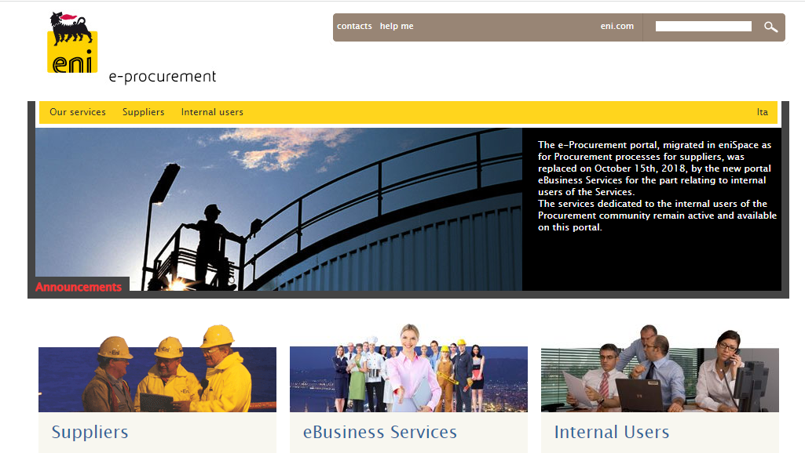
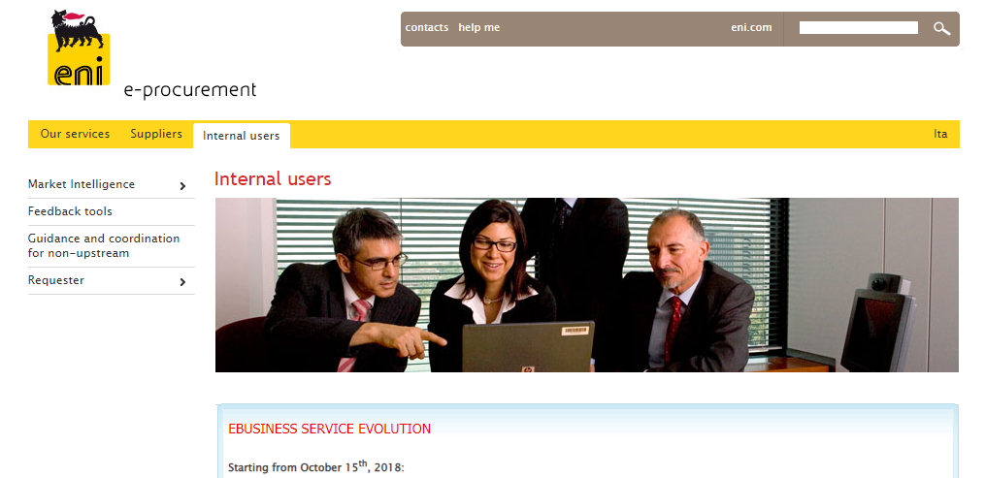
Where you can information and support
No password needed!
The portal (Procurement Community) is an area containing regulations, tools and information useful to Eni's Procurement Units
Within the portal you can find the FORM to request VMS authorization, to be sent to the email address Sistemi_di_Procurement@eni.com
Reference for more info:
vendor.development@eni.com

Slide 15

Un feedback non può cambiare il passato, ma può migliorare il futuro
A Feedback cannot change the past, but it can improve the future

Slide 16
List of 79 Relevant Commodity Classes

